Slide 1
Lakeshore Village Survey Results

Slide 2
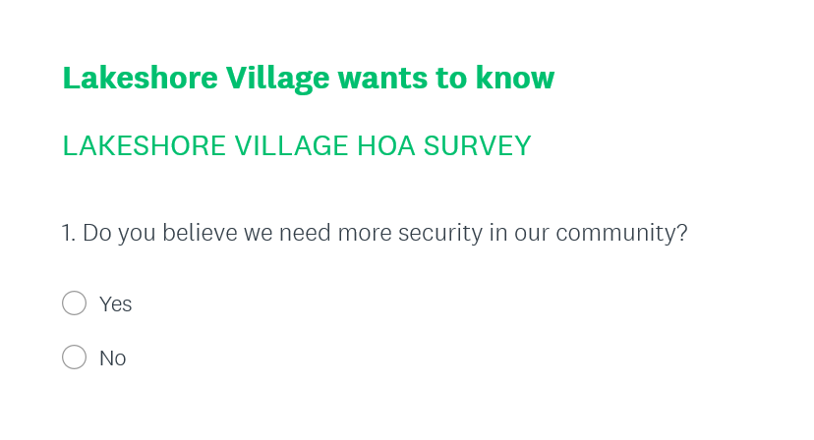
100 surveys sent – 60 returned
51% – yes 49% - no

Slide 3
What do you feel is a major concern in our community?
Gates being open - getting hit
Parking – guest parking
Traffic – Cars going to fast – thru traffic
Landscaping-need mulch - flowers
Pool –non-residents coming in - parties
Owners who rent –compliance
Following rules
Dog poop
Trash –put out to early
Garage Doors -need to keep Closed – re-stain
Mold on pool house –needs cleaned
Wasp / Bees –pest control
Street lights – to dark
Utility boxes –ugly sight

Slide 4
What improvements would you like to see in our community?
Landscaping
Pool area
Workout room
Extend pool
Meeting space
Pest control
Socials
What we are doing:
Survellance
Irrigation
Pool fixed
Socials

Slide 5
What do you like best about our community?
Location
Quiet
Friendly/Nice neighbors
Appearance
Do you find our website helpful?
100 surveys sent – 60 returned
98% - yes 2% - no

