Slide 1
Lakeshore Village Homeowners Association
October 15, 2019, 7:00PM
Cora Spencer Elementary School
3140 S. Camino Lagos
Grand Prairie, TX 75054

Slide 2
Introductions
Board of Directors
Dollie Smith - President
Cynthia Blake – Vice President
Andrew Tricomi–Duran – Vice President
Christopher Hills – Treasurer
Board Open Position - Secretary
FirstService Residential – Management Team
Portfolio Manager – Linda Claiborne
Director of Management – Markus Ashley

Slide 3
Assessment Collection Process
Annual Assessments are January 1st & July 1st
Delinquent – Assessments not paid by the 10th of the month are considered delinquent.
Reminder – $25 late fee + a 10% per annum interest charge that is assessed on the past due balances in addition to administration charges ($15).
2nd Notice – Assessments not paid within 30 days of the due date will be assessed additional late fee interest charge, as well as administrative charges ($38). Notice will be sent certified mail.
FSR Internal Demand – If assessments are not paid 60 days of the due date, FSR will send a 30 day notice of intent to refer the delinquent account to attorney for collections if not paid. At this time, we let you know of payment plan options and it is sent certified mail. If it is not paid, it is sent to the attorney for collections.
The association shall be entitled to recover from the Owner, its attorney’s fees and collection costs incurred in the collection of delinquent accounts. Those fees will be due and payable when incurred.

Slide 4
Violation Fining Process
Once a violation is received…
Courtesy Notice – Allows 10 days to correct the violation.
Notice of Violation (NOV) – Certified letter, 30 days to correct the violation or $50 fine assessed.
Notice of Fine (NOF) – if violation is not corrected by the date on the NOV a $50 fine will be assessed.
2nd Notice of Fine - If violation is not corrected within 30 days of the 1st NOF, an additional $100 fine will be assessed.
3rd Notice of Fine – If violation is not corrected in 30 days of the 2nd NOF, an additional $200 fine will be assessed.
If the violation is still not cured with 10 days of the 3rd NOF, an additional fine will be assessed every 10 days not to exceed $800.
REMINDER:
Temporary Improvements without ACC Approval - $200 fine
Solar Screens, Storm Windows, Landscaping, Painting, etc.
Permanent Improvements without ACC Approval - $500 fine
Fence, Patio Covers, Sheds, Gutters, Roof replacement, etc.

Slide 5
Parking Policy updates
Updated Parking Policy effective 10/30/2019
Removed the 4 “free” parking spaces from Piazza Court, on 10/30 these 4 parking spaces become Guest Parking only.
Do not park in driveways – creates fire hazard.
Owner/Renter cannot park their vehicles in Guest Parking (unless special permit allowed for the 3 days per year for maintenance).
Guest Parking – 10 days per mo. per owner, if not registered – 1st warning – 2nd Towing enforced. Owner needs passcode for registration of guest.
Be sure to have your correct license plates #, system will allow you to register however, you can still be towed if license does not match vehicle.
Parking requests should be sent to lakeshorevillagegp@gmail.com

Slide 6
Selling Your Home
No signs allowed – since we are gated
Lakeshore Village website splashpage available for home details and pictures
Send email to lakeshorevillagegp@gmail.com
We will need the following information:
Name, address, realtor name, email address & phone
The Board will:
Set up of temporary gate access for realtor
Coordinate open house for parking in guest spaces
Email community when/where open house

Slide 7
Gate Notifications
Please email fwreservations.tx@fsresidential.com with any gate keypad updates such as change or updates with phone numbers or passwords.
Please allow 72 hours
For emergencies call 877-378-2388
Our gates will be maintained by a gate management company - we are vetting one now.
Please do not crawl under back gates, or drive up quickly after previous car comes through as these swing gates are easily tripped and will always need to be reset if this happens, creating problems for us all.

Slide 8
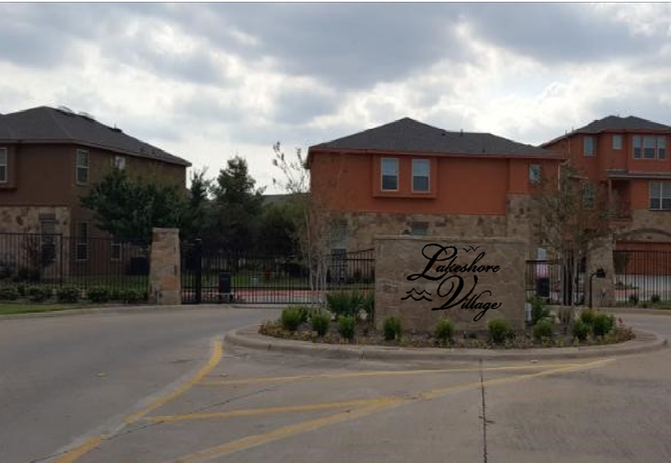
Lakeshore Village New Monument Signage

Slide 9
Neighborhood Committees Come Join the Fun!
Architectural Control Committee
Social Committee
Landscape Committee
Finance Committee
Legal Committee
If you are interested in serving on a committee, please complete the form located at the sign in table and return to Association Manager, Linda Claiborne tonight or via email at Linda.Claiborne@fsresidential.com.

Slide 10
Open Discussion
*Please complete a Speaker Card if you have a question. Use of speakers cards helps to ensure management has a record of your questions for timely follow-up. Thank you!

